Slide 1

100 L/s Sedimentation
Lily Pads
December 18, 2019

Slide 2
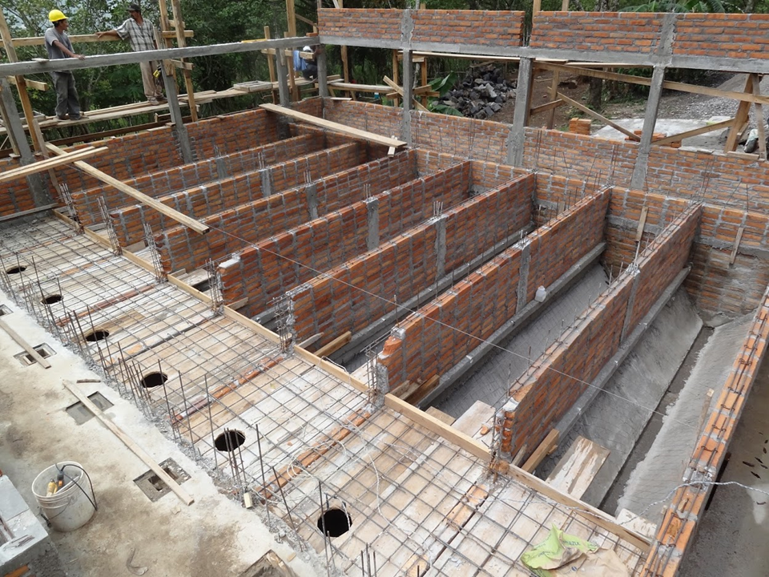
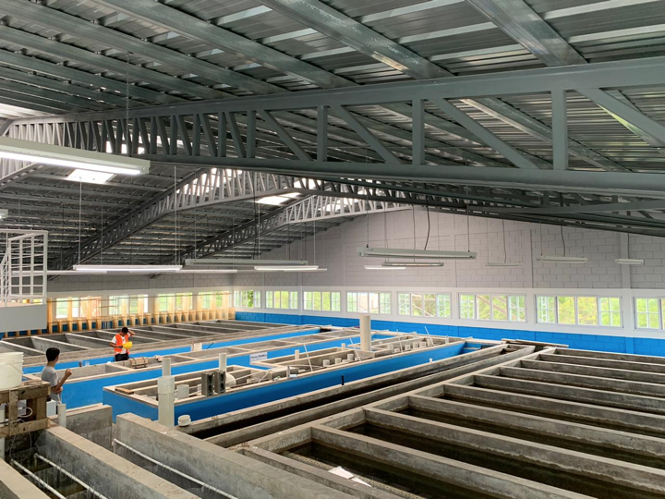

Introduction
The goal is to design sedimentation tanks with a high flow rate of 100 L/s, and to decide what is the optimal design depending on material costs, size considerations and feasibility of construction.
Notes:
Citations: Left Image: Sedimentation.ppt (Slide 8) Courtesy of Monroe-Weber Shirk, 2019
Right Image: Courtesy of Monroe-Weber Shirk, 2019 (Manifold ppt, pg. 1)
Originally, AguaClara was created to implement clean water to underserved communities. These regions were small in population, and so AguaClara water treatment plants had lower flow rates. With the growing communities, we would now like to have plants with higher flow rate capacities to have the ability to serve growing communities. The current plant design has 10 channels each with a flow rate of 6 L/s. This gives a maximum flow rate of 60 L/s for a traditional AguaClara plant. If higher flow rates are desired, 2 sedimentors are added so you can add the flow rates to get the plant flow rate, giving a plant flow rate of 120 L/s. Traditionally, the width of the sedimentation bay is determined by the width of plate settler. We are interested in designing plants with higher flow rates, so that we can service larger communities.
More flow rate double the number of sedimentors

Slide 3
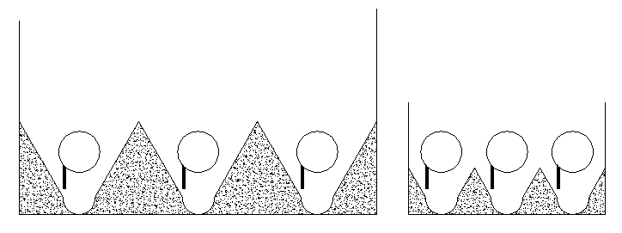
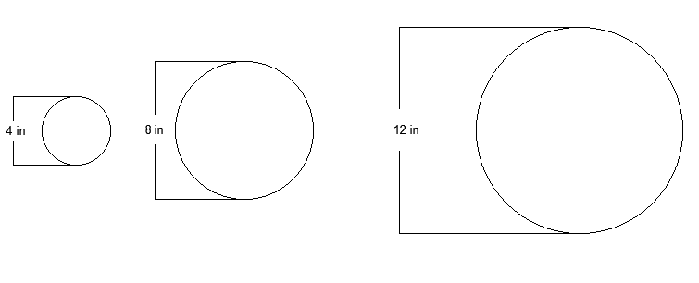
Method
Step 1: Remove the dividing walls - have one tank with multiple manifolds
Step 2: Check various pipe sizes for optimal design
Step 3: Consider cost and feasibility of construction to finalize optimal geometry
Notes:
Srilekha: Our overall approach was the following. First we removed the dividing walls, so that there is one tank with multiple manifolds. This allows us to play around with the manifold spacing and not be limited by the plate settler width. The second step was to check various pipe sizes for optimal designs and then consider cost and ease of construction to decide on the optimal geometry.

Slide 4
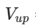
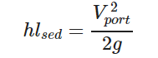
Design Process - Sedimentation Tank
The goal of this design is a flow rate of 100 L/s
2. The upflow velocity is 1 mm/s
3. Constraint: head loss through the ports
Set to 1 cm to account for energy losses for floc resuspension
Notes:
Srilekha- So first we assumed a flow rate of 100 L/s. This was set as a variable, so it could be changed for other designs. The upflow velocity was constrained at 1 mm/s. As shown in past AguaClara designs, this is a sufficient velocity to ensure floc resuspension. The head loss through the diffuser ports was also set at 1 cm, since there’s a small energy requirement to keep the floc blanket resuspended.

Slide 5
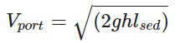
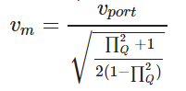
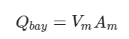
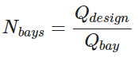
Design Process - Setup Optimization
4. Port velocity is calculated using the head loss equation 5. Manifold velocity is calculated using the Flow Ratio (Π_{Q})
6. Maximum flow rate for each pipe is determined 7. Number of bays is determined - rounded up to the nearest integer
Notes:
Srilekha- Using the 1 cm head loss, we can find the port velocity. Using the manifold equation and the port velocity we just found, we can find the manifold velocity. A flow ratio of 0.8 was determined to be an give an adequate flow distribution along the manifold. Using the manifold velocity and the cross sectional area of the manifold pipe, the flow rate through each bay can be found. Going back to our design flow rate and flow rate through each

Slide 6

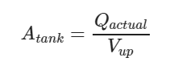
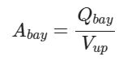
Design Process - Setup Optimization
8. Based on the number of bays, we back-calculate the plant flow rate
9. The plan view area of the tank is then determined
10. The plan view area of each bay can also be calculated
Notes:
Srilekha- Based on the flow rate through each bay and the number of bays, we can find the actual flow rate. Using the actual flow rate and the upflow velocity, we can find the plan view area of the tank. Using a similar process, we can find the plan view area of the bay.

Slide 7
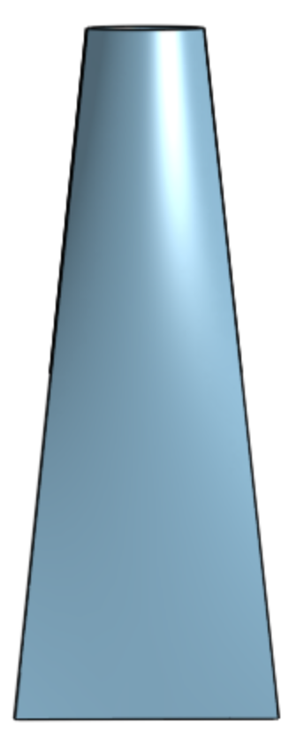
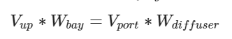
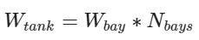
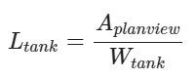
Design Process - Diffuser System
Option 1: Use current diffuser system
Width of diffuser = 3.175 mm
Using the continuity equation
Minimum width of bay = 1.4 m
Calculate total width of the tank
Length of tank can be calculated from the total plan view area
W_{diffuser}
Notes:
Irene

Slide 8
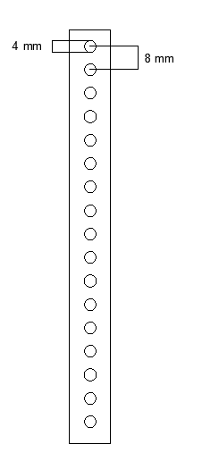
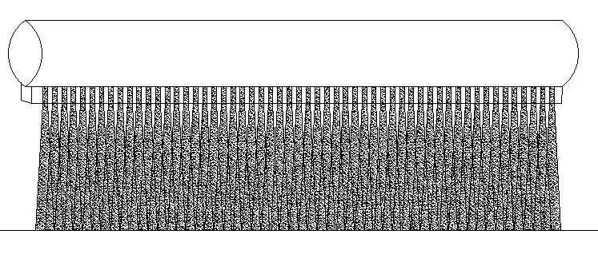
Design Process - Diffuser System
Option 2: Use circular ports with PVC slab to straighten the flow
Width of diffuser: 2.09 mm
Minimum width of bay: 0.93 m
Notes:
Irene

Slide 9
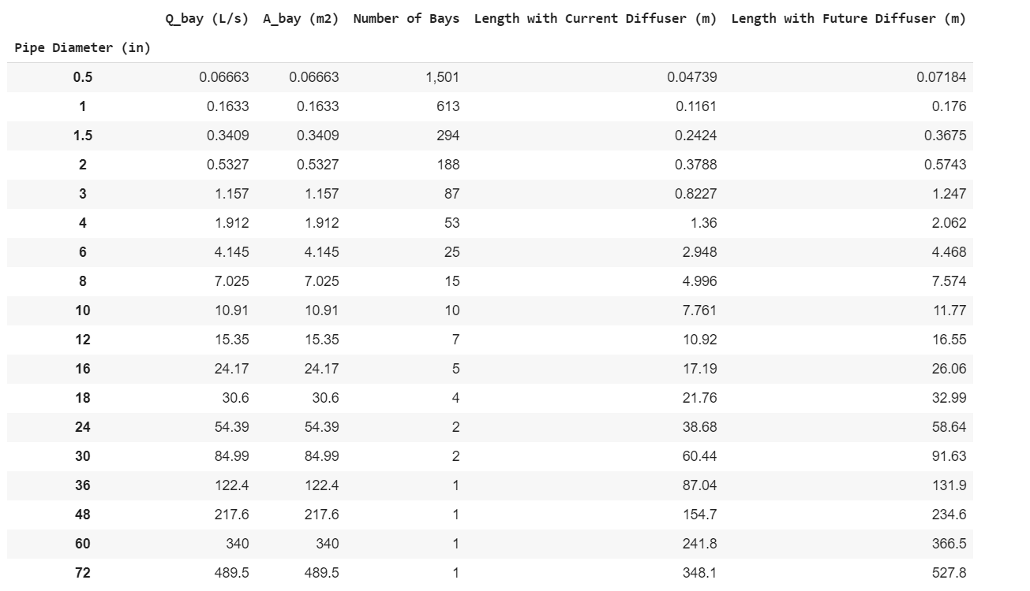
Notes:
Chau

Slide 10
Notes:
Chau

Slide 11
Width - Length Considerations
We have calculated the minimum width and maximum length of each bay (and therefore of the tank)
Let’s explore what happens at different width-length ratios!
Notes:
Irene

Slide 12
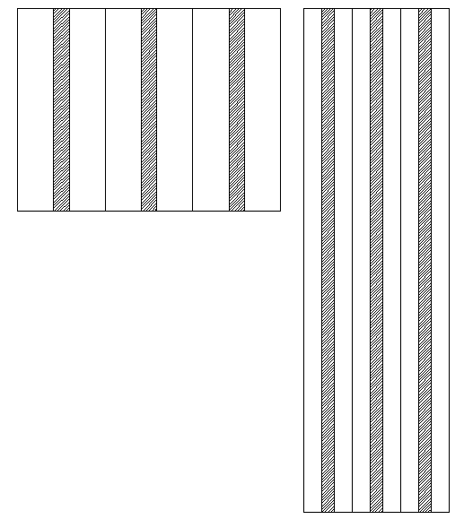
Width - Length Considerations
Notes:
Irene

Slide 13
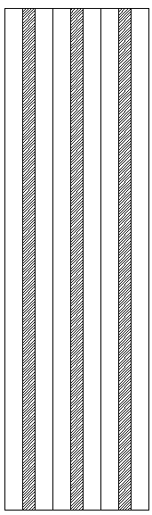
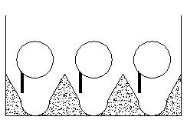
Width - Length Considerations
If we minimize width:
Minimize concrete used
Minimize depth
Maximize the amount of pipe needed
Notes:
Irene

Slide 14
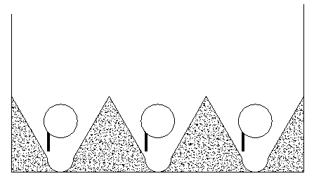
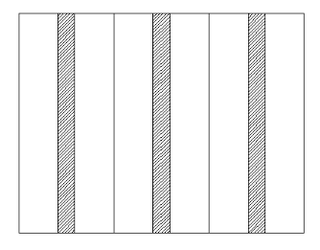
Width - Length Considerations
If we maximize width:
Maximize concrete used
Maximize depth
Minimize the amount of pipe needed
Notes:
Irene

Slide 15
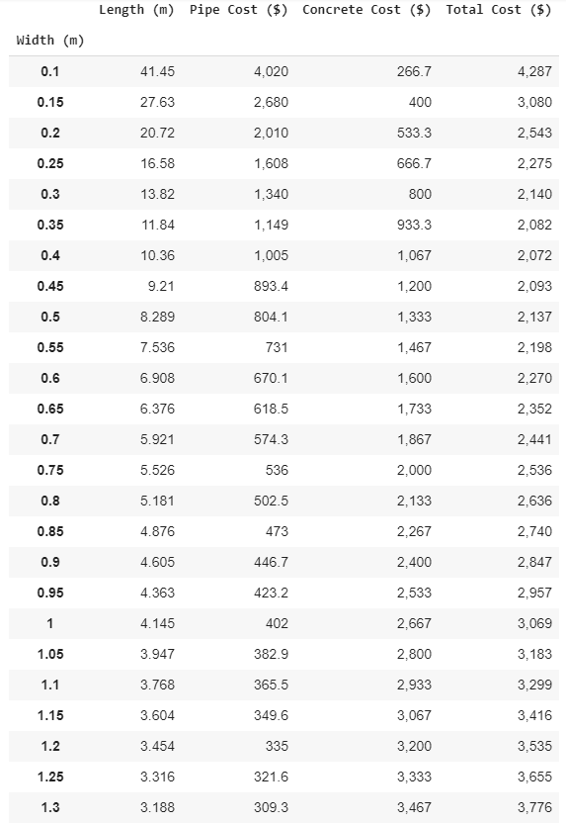
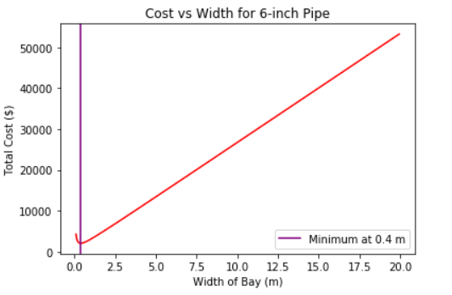
Cost Analysis
Notes:
Chau

Slide 16
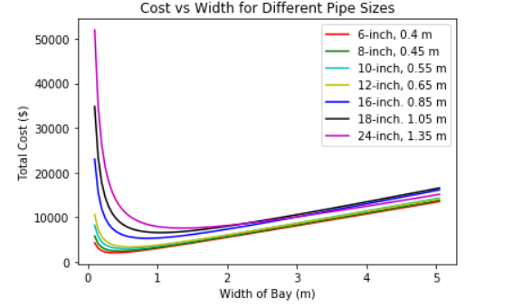
Cost Analysis
Notes:
Chau
For each viable pipe size, the sedimenter width was varied from 0.1 to 20 meters which changed the length of pipe and amount of concrete needed to fill the bottom shape of the bays. As the cost of pipe went down, the cost of concrete went up. Thus, finding the optimal plan view area for each pipe size in relation to cost.
Note: Only pipe and concrete costs were taken into consideration

Slide 17
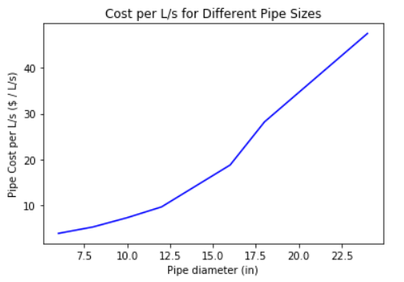
Cost per Unit Flow Rate
Notes:
Chau

Slide 18
Conclusions
These are recommendations for a 100 L/s design which can be amended if the design flow rate is higher
Minimizing the width of the tank increases construction feasibility, but cost needs to be considered
Concrete is the primary driver of cost
There is an optimal geometry for each pipe diameter based on cost which is limited by the diffuser system
Notes:
Srilekha

Slide 19
Recommended Design
Smaller diffuser width
The cheapest option for this width would be going with 6 inch pipes
Too many bays
Too many pipes
8 inch pipe design because of its similarity to current Aguaclara designs and its feasibility of construction
15 bays
7 m in length
1 m width of bay
$2,070
Notes:
Srilekha: 25 bays for 6 inch pipes
0.93 minimum width

Slide 20
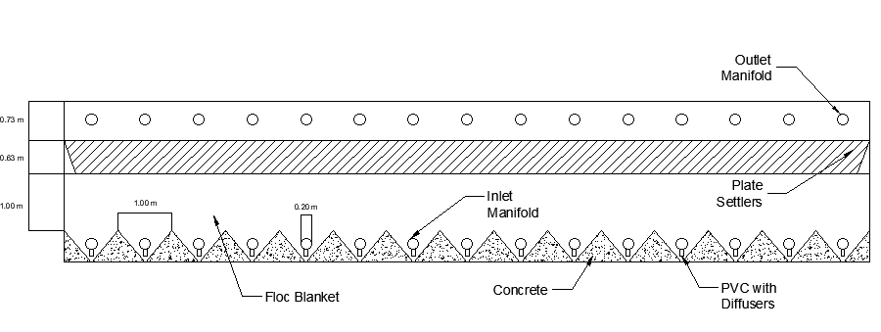
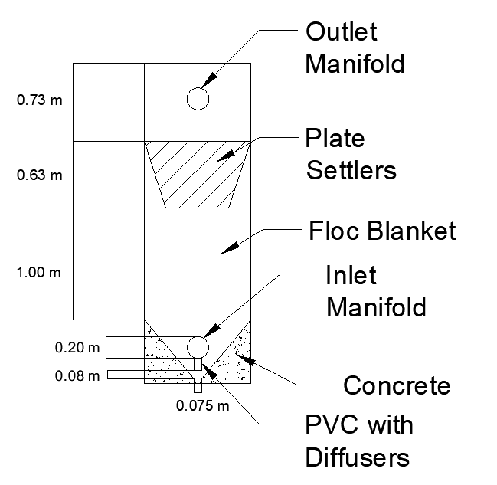
Notes:
Irene
Recommended Design CAD drawing - to scale: Side View

Slide 21
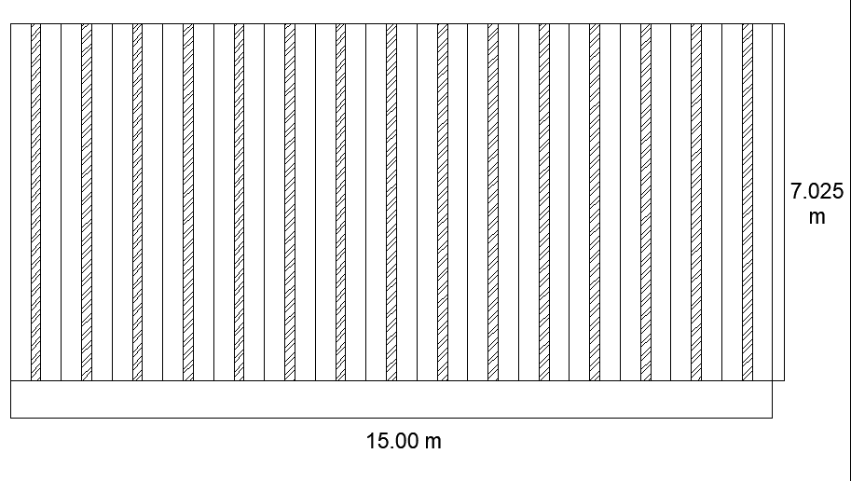
Notes:
Irene
Recommended Design: Plan View

Slide 22
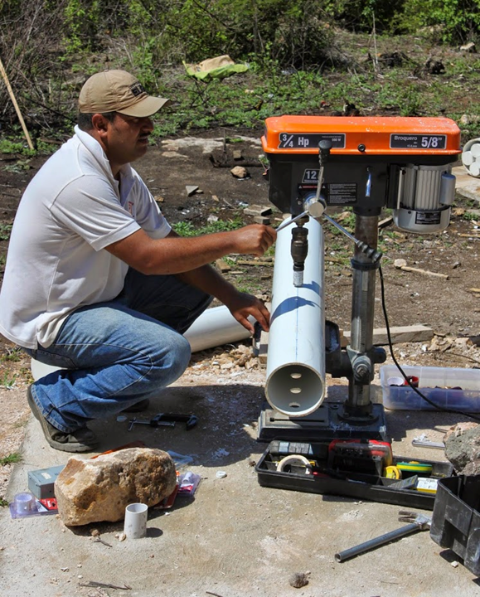
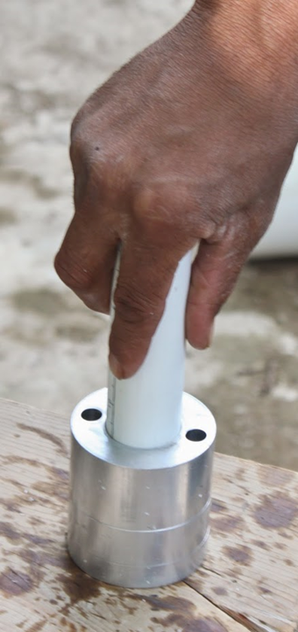
Future Work
Redesign of the Inlet Channel System and all upstream processes to accommodate the high flow rates needed in the sedimentation tank
Incorporating labor costs into Cost Analysis model
Rethink plate settlers and how they would be put in place without the dividing walls
Notes:
Srilekha

Slide 23
Thank You!
Questions?
Chau Nguyen (cvn9)
Eirini Sarri (es859)
Srilekha Vangavolu (sv397)

Slide 24
Appendix Slides

Slide 25
Table of Cost vs Width
Pipe Size (in) | Width Bay (m) | Optimal Cost ($USD)
6 in | 0.4 | $2,072
8 in | 0.45 | $1,356
10 in | 0.55 | $1,404
12 in | 0.65 | $3,387
16 in | 0.85 | $5,323
18 in | 1.05 | $6,603
24 in | 1.35 | $7,608

Slide 26
1 m width for all pipe sizes
Pipe Size (in) | Length (m) | Number of Bays | Flow Rate (L/s) | Cost ($USD)
6 in | 4.15 | 25 | 103.8 | $3,069
8 in | 7.025 | 15 | 105.4 | $3,267
10 in | 10.91 | 10 | 109.1 | $3,604
12 in | 15.35 | 7 | 107.5 | $3,802
16 in | 24.17 | 5 | 120.9 | $5,382
18 in | 30.6 | 4 | 122.4 | $6,603
24 in | 54.39 | 2 | 108.8 | $7,963

Slide 27
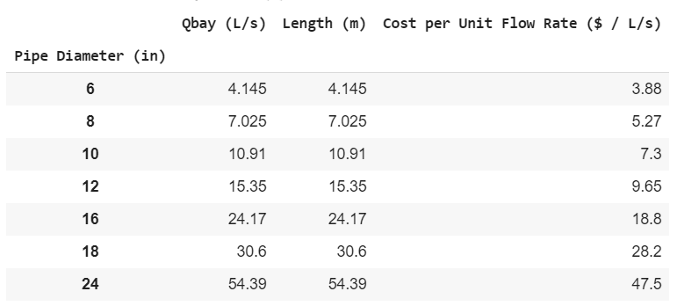
Cost Per Unit Flow Rate

Slide 28
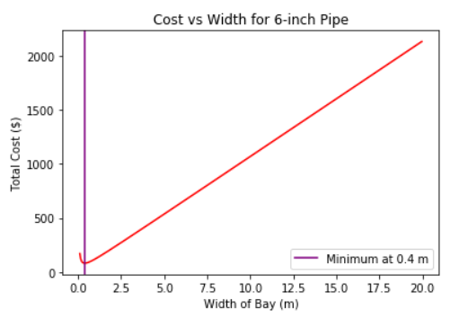
6-inch pipe

Slide 29
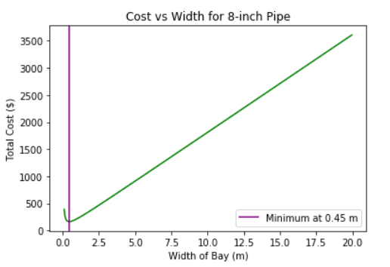
8-inch pipe

Slide 30
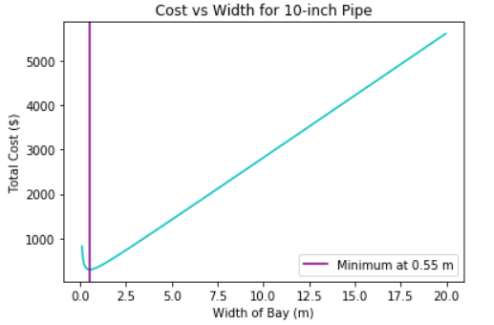
10-inch pipe

Slide 31
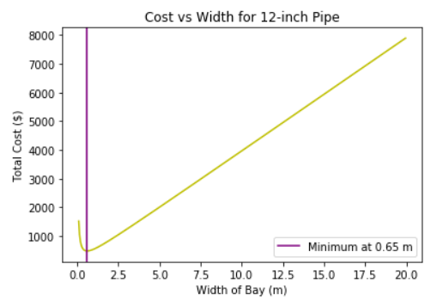
12-inch pipe

Slide 32
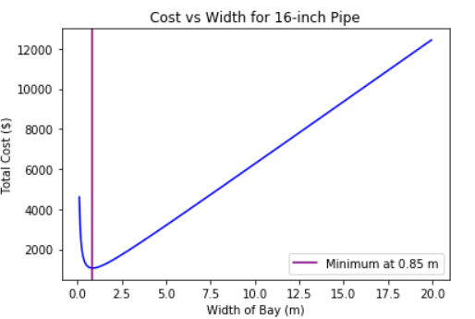
16-inch pipe

Slide 33
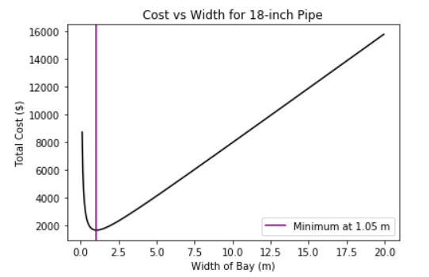
18-inch pipe

Slide 34
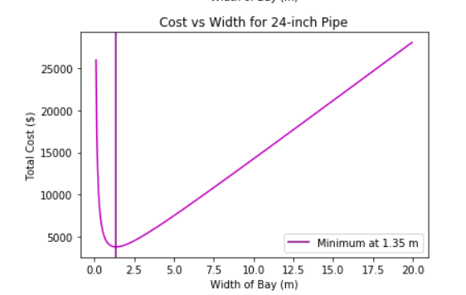
24-inch pipe

